Slide 1
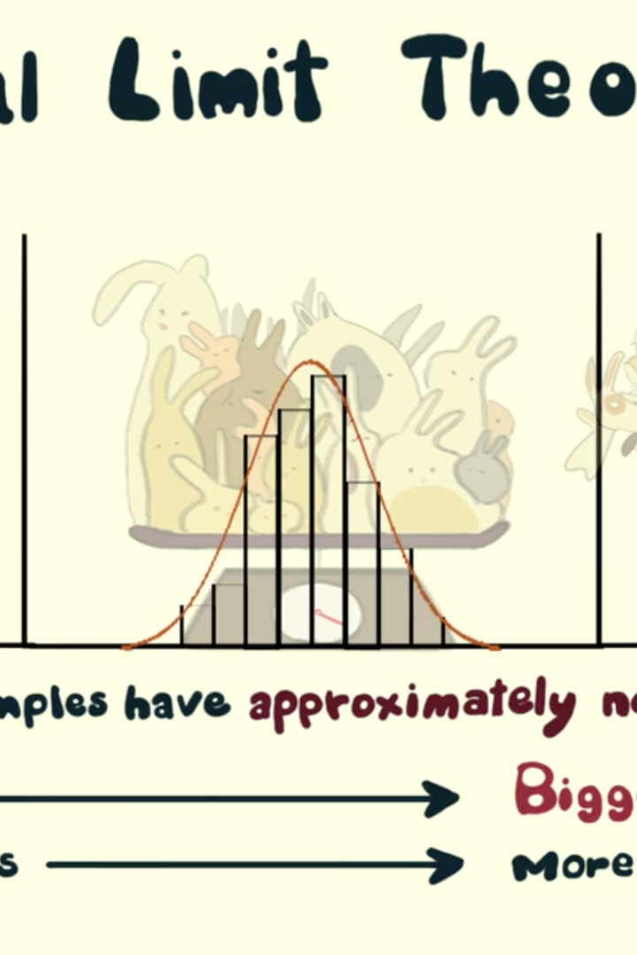
The Central Limit Theorem
The central limit theorem is a fundamental concept in statistics that states that the distribution of samples will approach a normal distribution, regardless of the shape of the population distribution.

Slide 2

Definition of the Central Limit Theorem
The central limit theorem states that the sum or average of a large number of independent and identically distributed random variables will tend to have a normal distribution.

Slide 3

Explanation of the Central Limit Theorem
This theorem is crucial in inferential statistics as it allows us to make inferences about a population based on a sample. It provides a foundation for hypothesis testing and confidence intervals.

Slide 4

Importance of the Central Limit Theorem
The central limit theorem allows us to make accurate statistical inferences even when the population distribution is unknown or non-normal. This makes it a powerful tool in many areas of research and decision-making.

Slide 5
Assumptions of the Central Limit Theorem
The central limit theorem assumes that the random variables are independent, have a finite variance, and are identically distributed. Violations of these assumptions can affect the validity of the theorem.

Slide 6

Application of the Central Limit Theorem
The central limit theorem is widely used in various fields such as quality control, finance, and social sciences. It helps to analyze and interpret data, estimate parameters, and make predictions.

Slide 7

Limitations of the Central Limit Theorem
While the central limit theorem is a powerful tool, it may not hold true for small sample sizes or for populations with heavy-tailed distributions. In such cases, alternative statistical techniques may be more appropriate.

Slide 8

Conclusion and Key Points
The central limit theorem is a fundamental concept in statistics that allows us to make reliable inferences based on sample data. Understanding its assumptions, limitations, and applications is crucial for accurate statistical analysis.

Slide 9

Thank you!!

